Slide 1


Social Content Data Analysis
Accelerating Growth and Streamlining Data Practices

Slide 2

Agenda
Problem Specification
The Analytics Team
Insights
Summary

Slide 3


Problem
Social Buzz is a social media company that has experienced rapid growth over the past 5 years. They have reached over 500 million active users each month and generate a massive amount of data every day. This data is highly unstructured and requires sophisticated technology to manage and maintain.
Social Buzz is looking to complete an IPO by the end of next year and they need help to ensure that this goes smoothly. They are also looking to learn data best practices from a large corporation so that they can manage their data more effectively.

Slide 4
Social Buzz is a fast growing technology Unicorn that need to adapt quickly to it’s global scale.
Accenture has begun 3 months POC focusing on the following task
An audit of Social Buzz big data practice
Recommendation for successful IPO
Analysis to find Social Buzz’s top most popular content categories , sentiment linked to them
Project Recap
Notes:
POC stands for Proof of Concept. he purpose of a POC is to answer the following questions:
Is the idea feasible?
Can the product or service be built?
Is there a market for the product or service?
What are the challenges that need to be addressed?

Slide 5


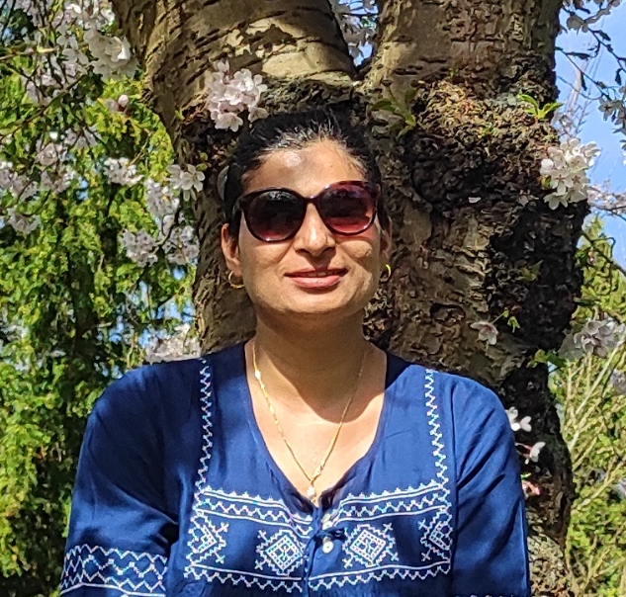
The Analytics Team
Andrew Fleming
(Chief Technical Architect)
Marcus Rompton (Senior Principle)
Harkeerat
(Data Analyst)

Slide 6

Understanding the Problem
1
Data Analysis Process
Data Cleaning
2
Data Modelling
3
Visualization and Data Analysis
4
5
Insights and Storytelling

Slide 7
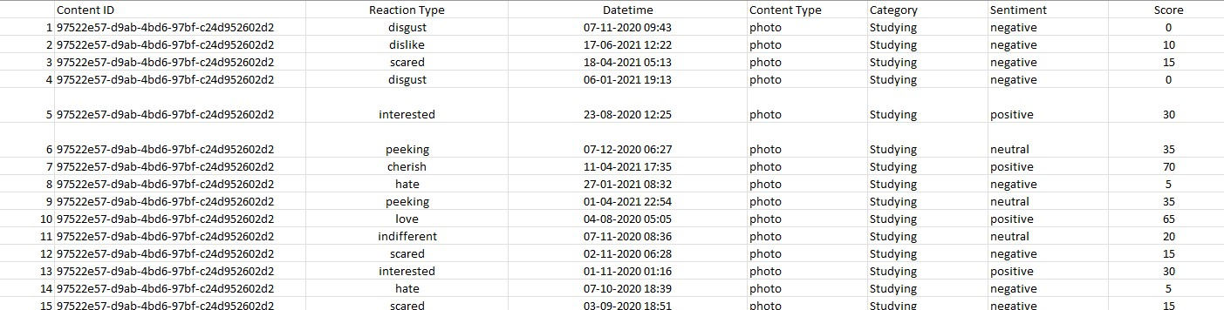
Reaction Dataset
Insights

Slide 8


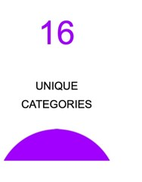
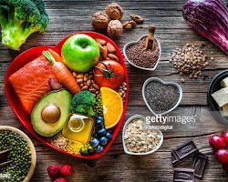









Unique Categories
Insights
Animals
science
healthy eating
technology
food
culture
travel
cooking
soccer
education
fitness
Studying
dogs
tennis
veganism
public speaking

Slide 9
Top 5 Category Score
Maximum score is 74K+
Most liked Category is ‘Animals’
Science is the next best liked category with a difference of ~3,700 point with Animals

Slide 10
ood is a basic need, and people are always interested in learning about new recipes and cuisines.
Popularity percentage share from top 5 categories
Animals are the most popular topic, with ~21%..
Technology is constantly evolving, and people are always looking for new ways to use it.
Food (~19%) is basic and people are always interested about new recipes and cuisines

Slide 11
Top categories with reaction to post
Maximum reaction is to Animal Post more than 1.8K and in January
The second most popular category is Science, users are interested in learning more about the world around them.
This information could be used to create more content that is relevant to users' interests.

Slide 12
Sentiment Analysis of top 5 Categories
The most popular sentiment about each topic is positive. This suggests that people are generally positive about these topics.

Slide 13
Month wise post for all 16 categories
The month with the most scores is May, with 2138 scores.
The least popular month is February, with 1914 scores
There is a clear trend of increasing scores from May to August (Summer), followed by a decrease in scores from September to February(Winter).
This information could be used to plan content and promotions that are more likely to be successful during different times of the year.

Slide 14
Month wise post for all 16 categories
Photo (262K views):
Photos are easy to consume and share, and they can be used to capture a wide range of emotions and experiences.
Video(246K Views):
Videos are a great way to tell stories, educate viewers, and entertain them. They can also be used to create more engaging and interactive content.
GIF (238K Views):
GIFs are short, looping videos that can be used to express a wide range of emotions and ideas. They are often used to share funny or interesting moments, or to add a bit of humor to a conversation.
Audio (226K Views):
Audio can be a powerful way to connect with viewers, as it allows them to hear the voices and stories of others.
Notes:
This suggests that users are more active on the platform during the summer months and less active during the winter months.

Slide 15
Analysis
Animals and Science are the most popular content showing people enjoy “Real” and “Factual” Life.
Users are more active on the platform during the summer months and less active during the winter months.
The most popular sentiment about each topic is positive. This suggests that people are generally positive about these topics.
Food is a common theme with top 5 Categories with “Healthy Eating” ranking the highest. Social Buzz can use this to create a campaign and work with healthy brands to boost user engagement.
Notes:
This suggests that users are more active on the platform during the summer months and less active during the winter months.

Slide 16



